Slide 1
Term Project-EDA
DSC530-T302 Data Exploration and Analysis (2217-1)
Prashant Raghuwanshi
Bellevue University
Guided by Professor Matthew Metzger

Slide 2
Outline
Background
Final Topic of Research
List Of Questions
Assumptions
Ethical consideration
References

Slide 3
Background
Exploratory Data Analysis refers to the critical process of performing initial investigations on data so as to discover patterns, to spot anomalies, to test hypothesis and to check assumptions with the help of summary statistics and graphical representations.
This Presentation is the Part of EDA Term End DS project
This presentation is focused on preparing the datasets for solving problems

Slide 4
Topics of Research
How accurately can we classify whether a sample from a body of water is potable, given its chemical and physical characteristics?

Slide 5
Statistical question/hypothesis
Explore more on variables and list down the information about them
Do the used data set is having missing values
Do the variables are having any unusual observations (outliers) or any gaps in the data.
Find out the type of distributions in datasets variables
Do any variables are having normal distributions
What CDF and PMF says if compare the portable and non portable datasets for Ph variables
Find out the Analytical distribution for ph variable (Actual Vs Model) data
What hypothesis test results says
How portability is fit linearly with other variables like Ph and Hardness

Slide 6
Selected Variables from dataset for analysis -1
Details of Variables
pH value:
PH is an important parameter in evaluating the acid–base balance of water. It is also the indicator of acidic or alkaline condition of water status. WHO has recommended maximum permissible limit of pH from 6.5 to 8.5. The current investigation ranges were 6.52–6.83 which are in the range of WHO standards.
Hardness:
Hardness is mainly caused by calcium and magnesium salts. These salts are dissolved from geologic deposits through which water travels. The length of time water is in contact with hardness producing material helps determine how much hardness there is in raw water. Hardness was originally defined as the capacity of water to precipitate soap caused by Calcium and Magnesium.

Slide 7
Selected Variables from dataset for analysis -2
Solids (Total dissolved solids - TDS):
Water has the ability to dissolve a wide range of inorganic and some organic minerals or salts such as potassium, calcium, sodium, bicarbonates, chlorides, magnesium, sulfates etc. These minerals produced un-wanted taste and diluted color in appearance of water. This is the important parameter for the use of water. The water with high TDS value indicates that water is highly mineralized. Desirable limit for TDS is 500 mg/l and maximum limit is 1000 mg/l which prescribed for drinking purpose.
Chloramines:
Chlorine and chloramine are the major disinfectants used in public water systems. Chloramines are most commonly formed when ammonia is added to chlorine to treat drinking water. Chlorine levels up to 4 milligrams per liter (mg/L or 4 parts per million (ppm)) are considered safe in drinking water.

Slide 8
Selected Variables from dataset for analysis -3
Turbidity:
The turbidity of water depends on the quantity of solid matter present in the suspended state. It is a measure of light emitting properties of water and the test is used to indicate the quality of waste discharge with respect to colloidal matter. The mean turbidity value obtained for Wondo Genet Campus (0.98 NTU) is lower than the WHO recommended value of 5.00 NTU.
Portability (Target) :
Indicates if water is safe for human consumption where 1 means Potable and 0 means Not potable.

Slide 9
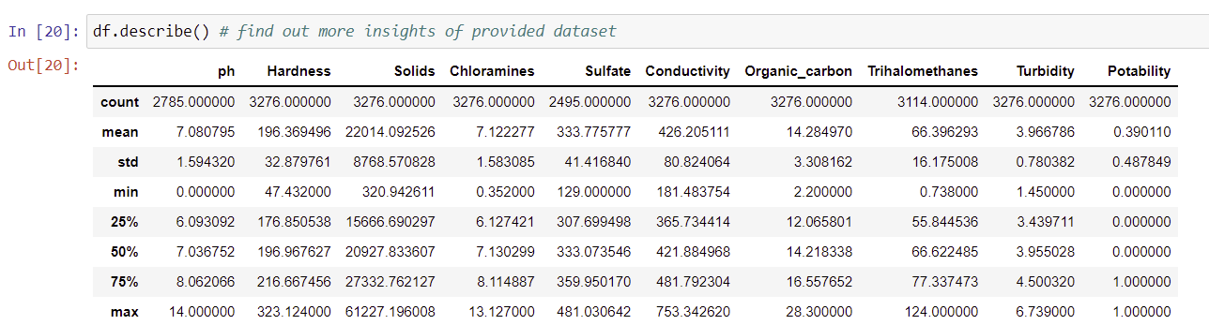
Describe the variables in the dataset

Slide 10
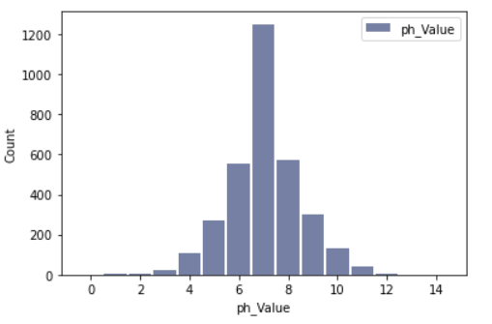
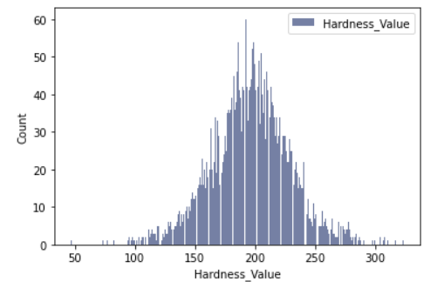
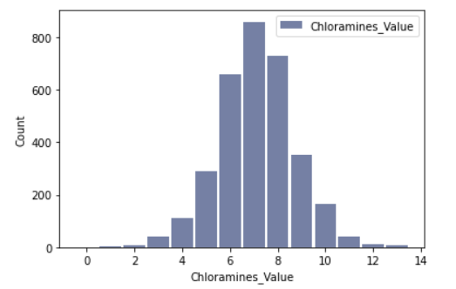
Histogram for each of the variables -1

Slide 11
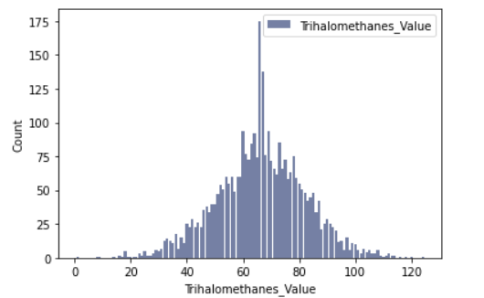
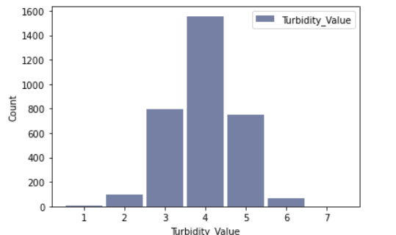
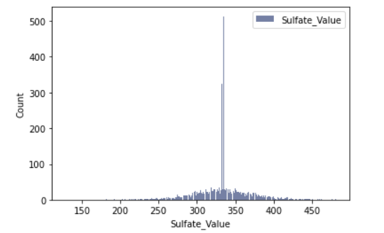
Histogram for each of the variables-2

Slide 12
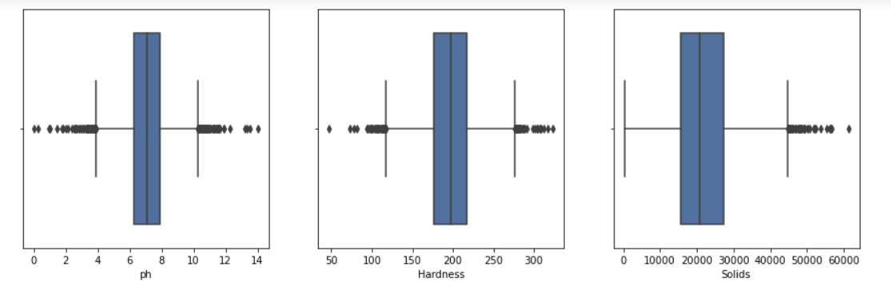
Outliers for each of the variables-1

Slide 13
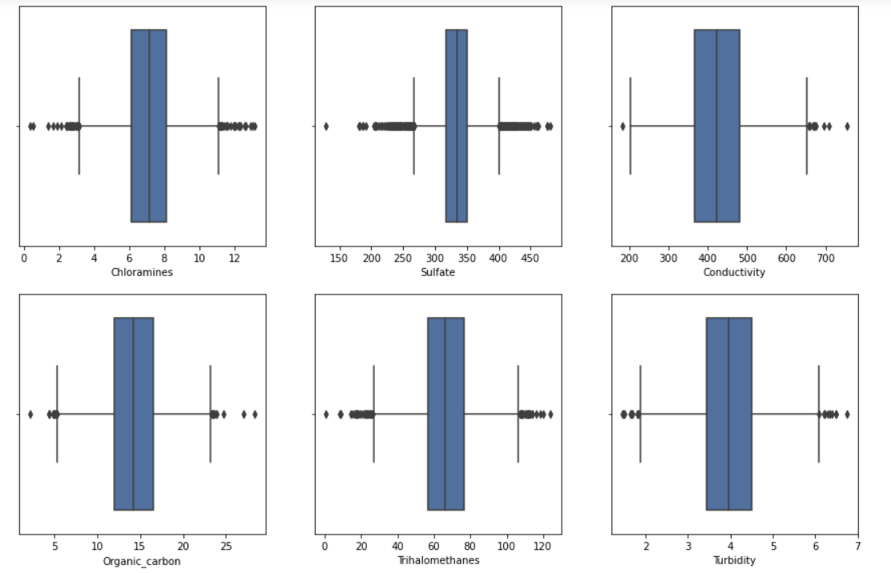
Outliers for each of the variables-2

Slide 14
Descriptive characteristics about the variables in the dataset

Slide 15
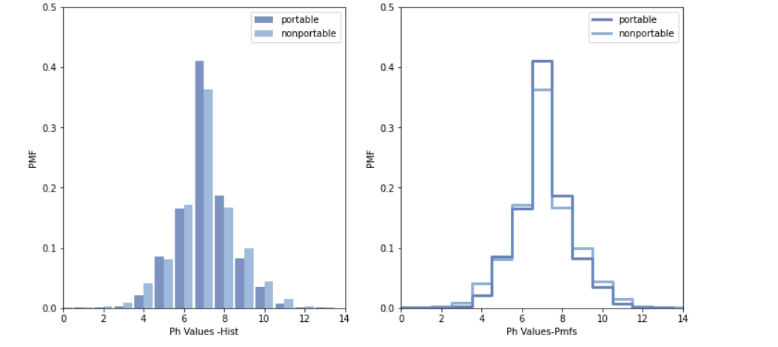
Compare two scenarios in data using a PMF (Portable Vs Non Portable)

Slide 16
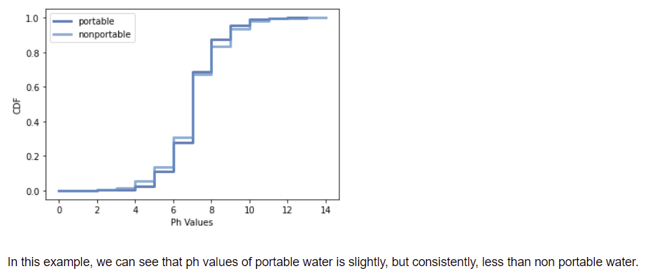
Compare two scenarios in data using a CDF (Portable Vs Non Portable)

Slide 17
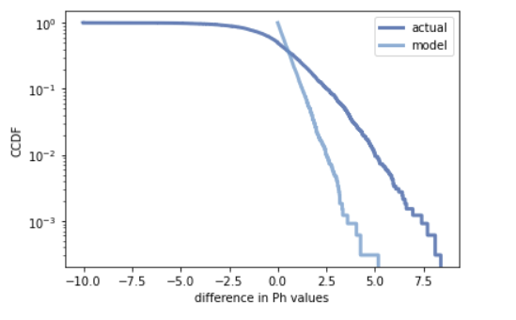
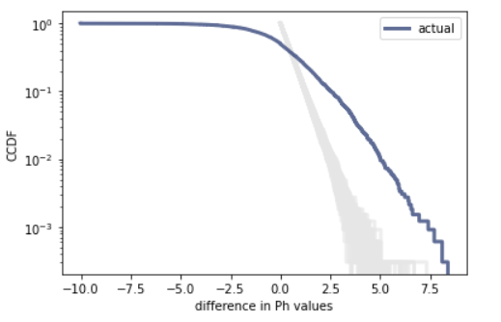
Analytical distribution for ph variable (Actual Vs Model)

Slide 18
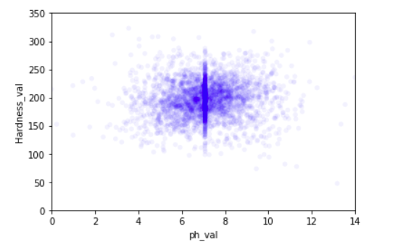
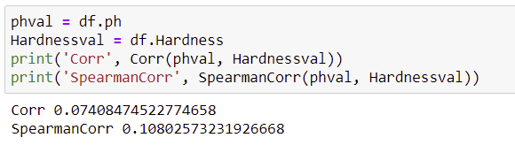
Scatter plots comparing two variables (Ph Vs Hardness)

Slide 19
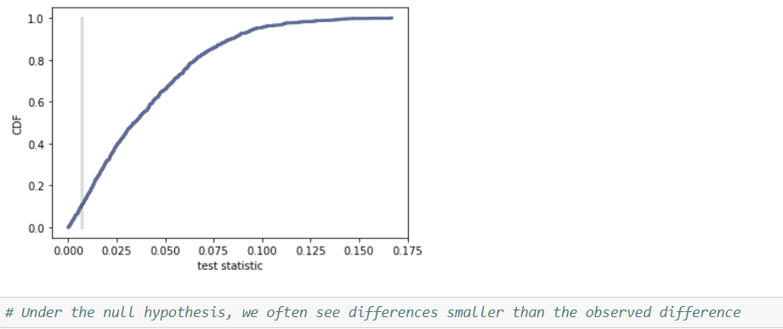
Conduct a test on hypothesis

Slide 20
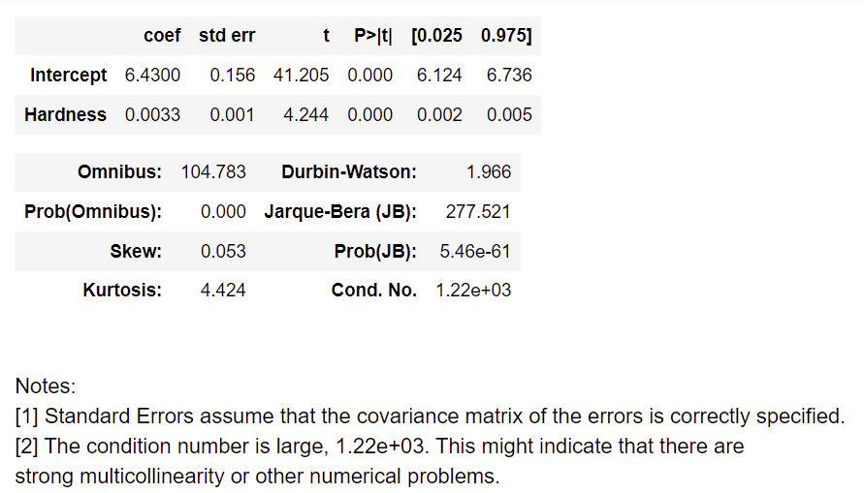
Conduct a regression analysis
Portability ~ Hardness

Slide 21
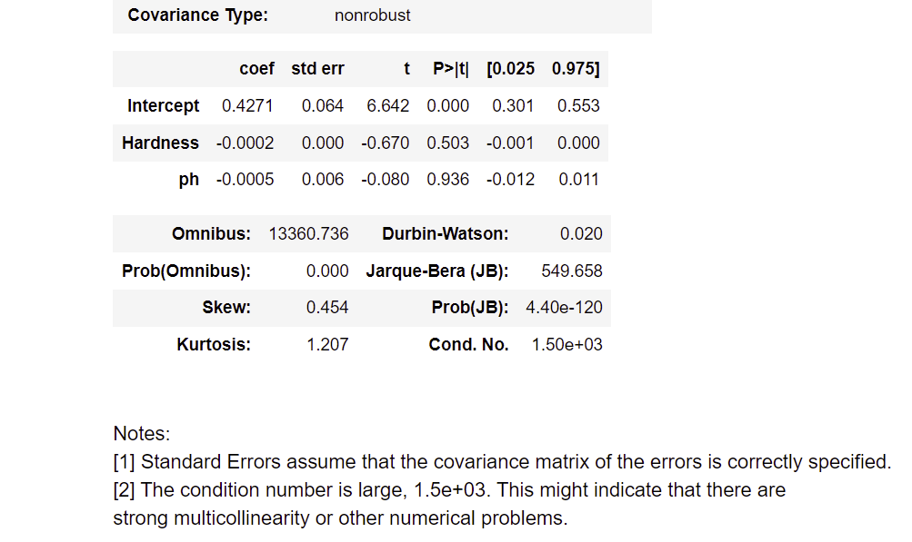
Conduct a regression analysis
Potability ~ Hardness + ph~ Hardness

Slide 22
References
Think Stats by Allen B Downey
Web references:
https://courses.lumenlearning.com/introstats1/chapter/skewness-and-the-mean-median-and-mode/
https://www.kaggle.com

Slide 23
Thank you

